Slide 1

CLINIC MANAGEMENT SYSTEM
ADBMS MINI PROJECT
Group 3
33312 - Kshitij Deshpande
33313 - Vedant Deshpande
33323 - Aditya Kangune
33356 - Yash Patwardhan

Slide 2
CONTENTS
Project Idea
Abstract
User Journey
Flow Diagram
Security Features
Technology
Value & Impact
Implementation Screenshots
Future Scope
Conclusion

Slide 3
PROJECT IDEA
Developing a secure portal where a doctor can connect with all their patients, access all the medical records, previous prescriptions and address new medical issues of the patients at one place.
The patients will be able to see their prescription history including the latest prescription issued by the doctor. The patient can go to the pharmacy or contact their pharmacist who is the third stakeholder in this project.
A pharmacist can also sign up on the platform but they will only be able to login through an OTP sent to the registered email ID of the patient who has contacted them.

Slide 4
ABSTRACT
The management of a clinic with the data of doctors, patients and pharmacists is a tedious and complicated task. The problems faced by traditional clinics leading to improper storage of important and critical data of the patients are the reason why there is a need for a simple online application with proper roles of a doctor, a patient and a pharmacist. This mini project shows how a complicated human task of storing critical data and timelines can be solved by using a mongoDB as the key tool in the development. The basic functionality of the system is to keep track of prescriptions of the patients where there are important details like date of prescription, medication name, dosage and symptoms. The tech-stack includes HTML, CSS, Bootstrap and Javascript for the frontend, MongoDB as the database and NodeJS/Express as the backend. Various different features for different roles of the doctors, pharmacists and the patients will make this system a very powerful clinic administrative system. The security model used based on different privileges for different users also will make the system a real-life application.

Slide 5
USER JOURNEY - DOCTOR
Fast and secure sign up feature.
Login will be possible only through registered email ID & account password. After login, the doctor will be able to see their profile and patients data.
After clicking on My Patients, they can see the medical history as well as submit a new prescription based on the recent consultation.

Slide 6
USER JOURNEY - PATIENT
Fast and secure sign up feature.
Login will be possible only through registered email ID & account password.
After login, the patient will be able to see ONLY THEIR OWN profile and prescription history.
If a new prescription has been submitted by their doctor, they will receive it on their dashboard.
There is one-to-one correspondence between the doctor and patient. One patient's data cannot be accessed or tampered by any other patient or user.

Slide 7
USER JOURNEY - PHARMACIST
Fast and secure sign up feature.
Login will be possible only through registered email ID and account Password The next step of verification requires the pharmacist to enter the email ID of the patient and OTP is sent to the registered email ID of the patient.
After login, the pharmacist will be able to see only that particular patient's most recent prescription.
The pharmacist does not have access to any other information about the patients and doctors registered on the portal.

Slide 8
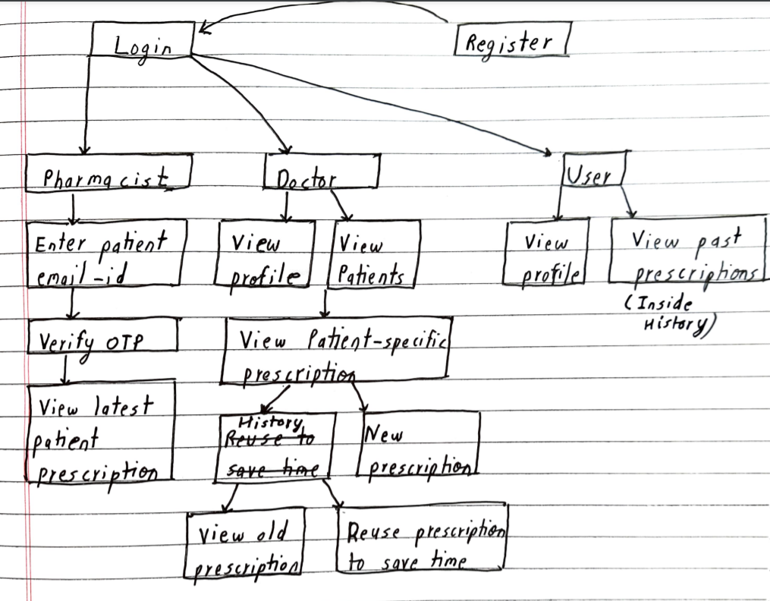
FLOW DIAGRAM

Slide 9
SECURITY FEATURES IN THE PROJECT
The platform uses the passport library for authentication (json web tokens are used for session management).
Access is granted to the pharmacist only after consent of patient. (OTP service is used)
Passwords are encrypted (hashed) using bcrypt library so that they are not exposed.
Patients can access only their own data and not of other patients. Implementing blockchain features (future scope).

Slide 10
TECHNOLOGY
Website Development
HTML
Styling - CSS + Bootstrap
Javascript
Database - MongoDB
Backend - NodeJS/Express

Slide 11
VALUE & IMPACT
Common platform for doctors, patients & pharmacists. Solving the problem of handwritten prescriptions.
Solving the problem of keeping track of medical history of each patient in paper format.
Solves the problem of going physically to medical shop, fast access to
prescription for pharmacist.
Fast and secure system where patient's data is protected and not accessible by any other patient or user.
Patients with recurrent health problems can get prescriptions without any hassle.

Slide 12
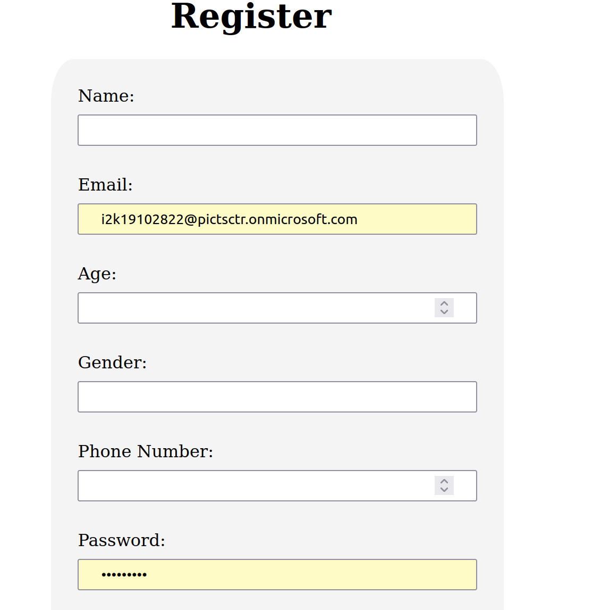
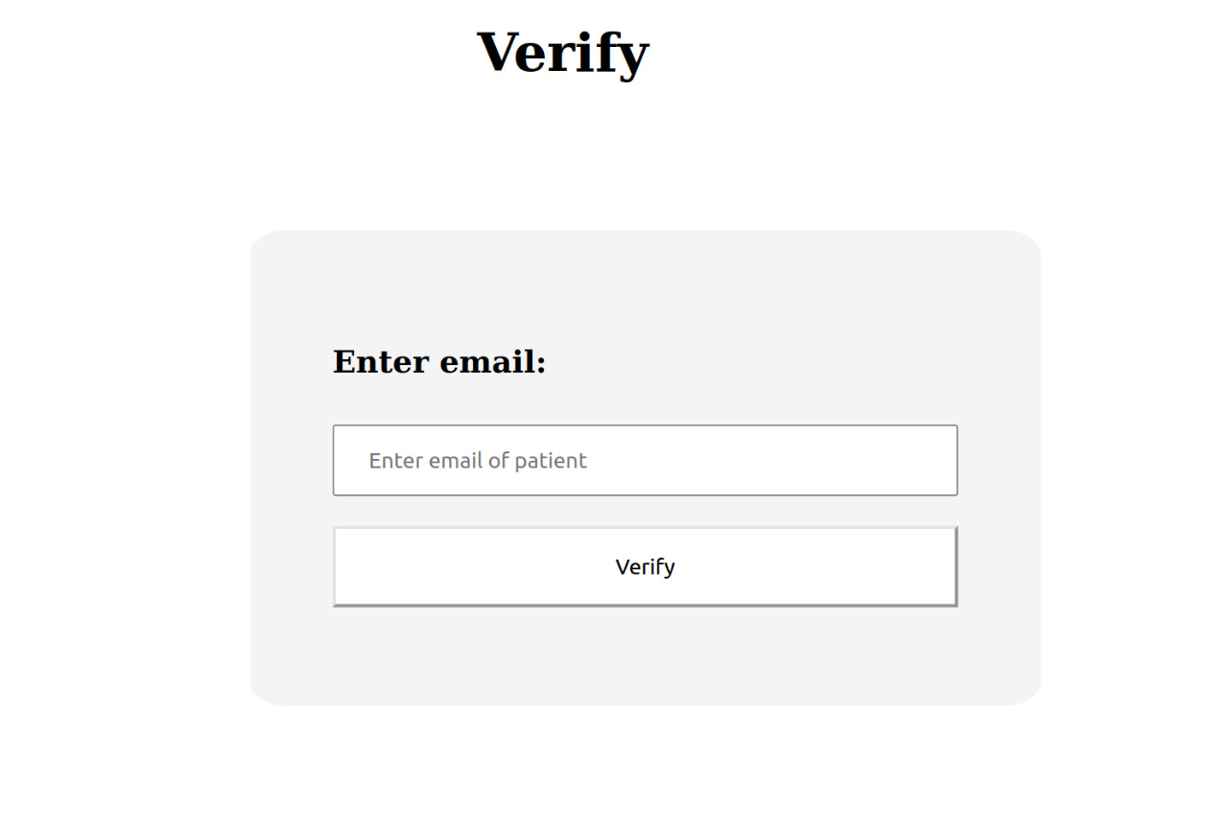
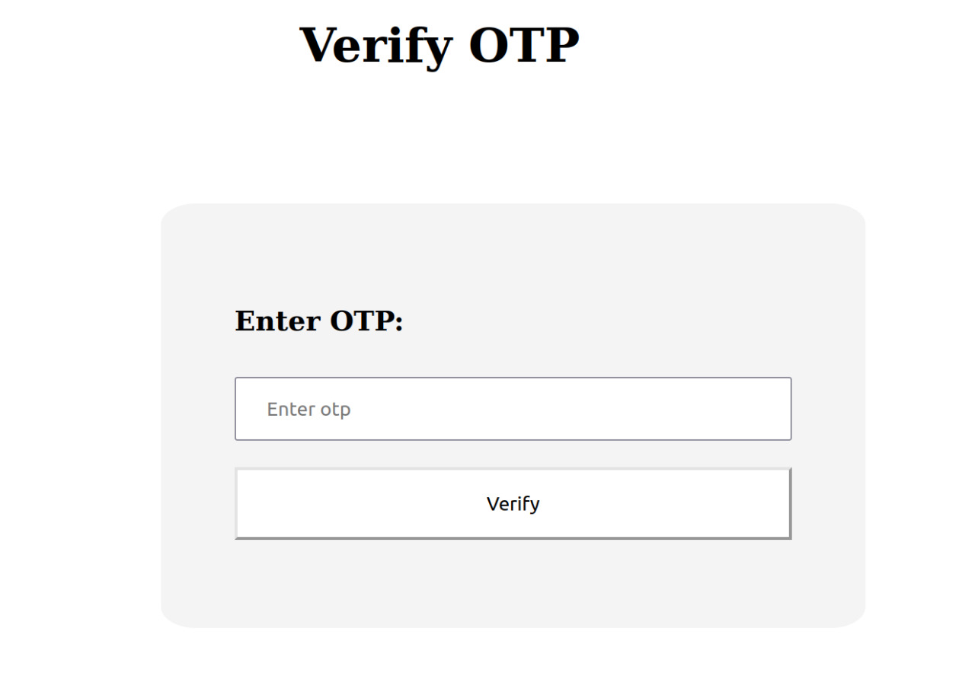
IMPLEMENTATION SCREENSHOTS

Slide 13
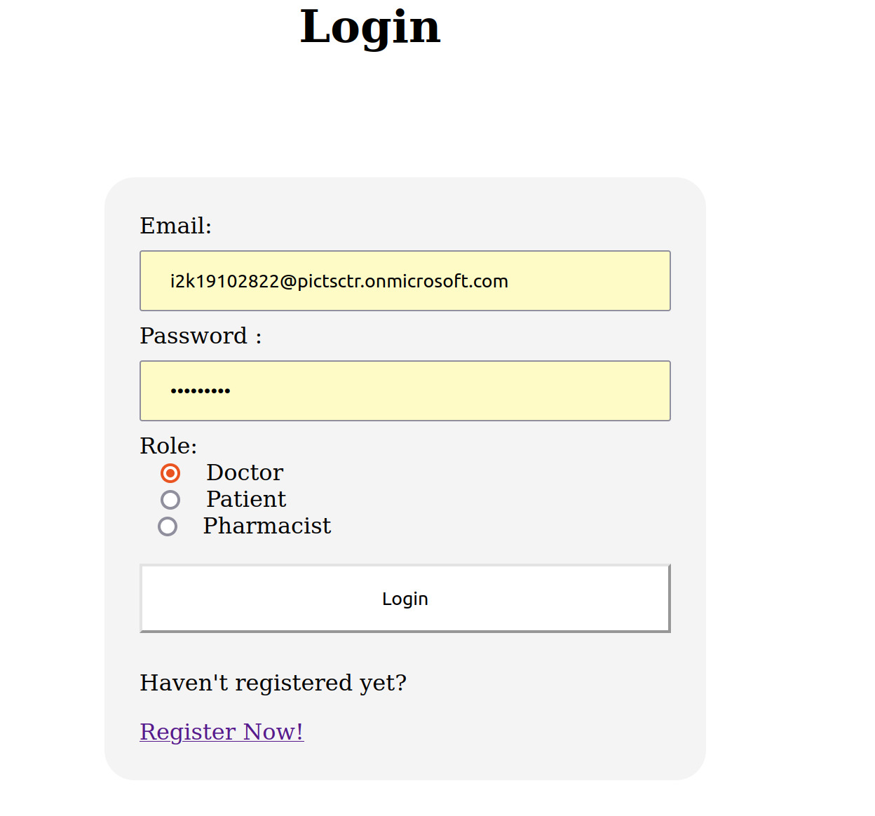
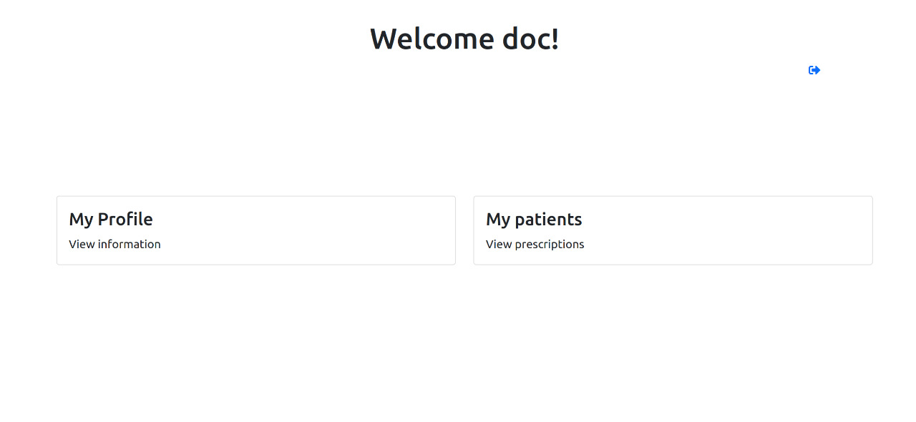

Slide 14
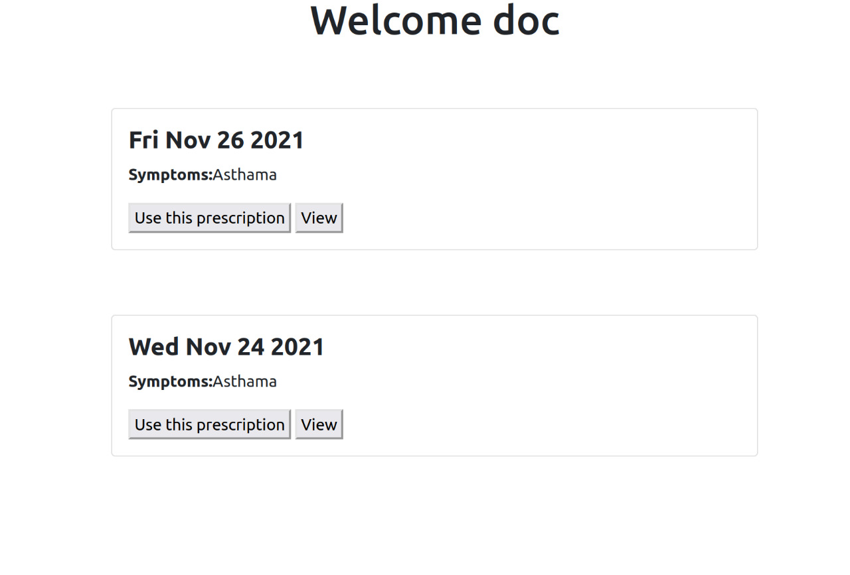
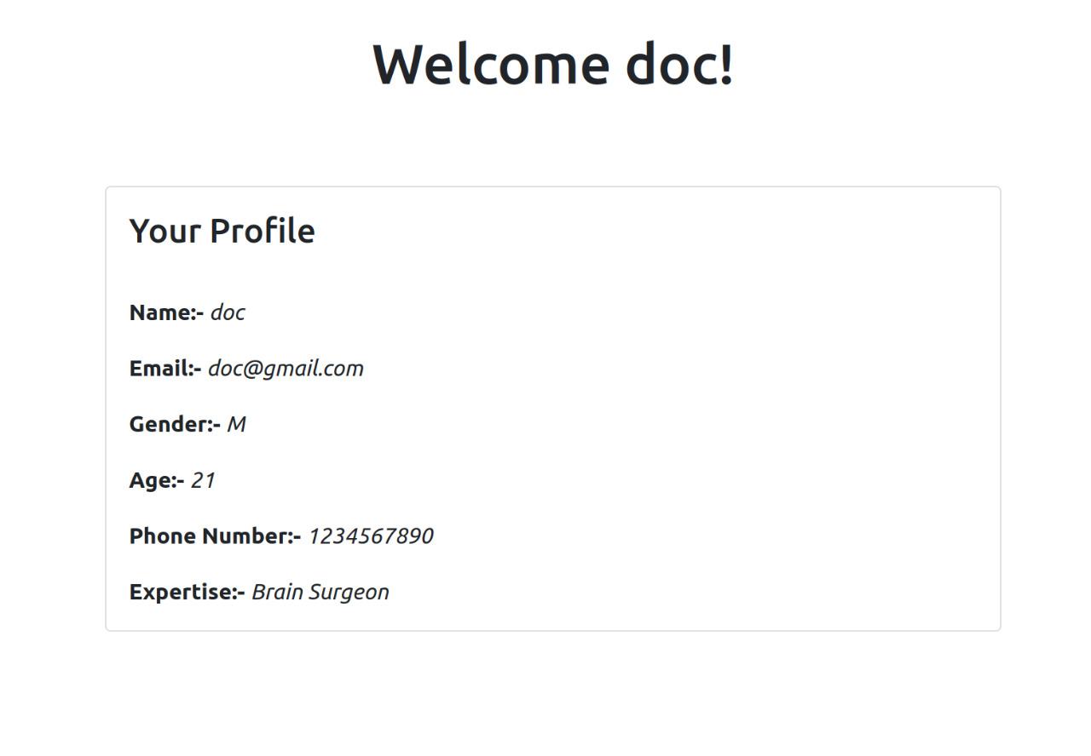

Slide 15
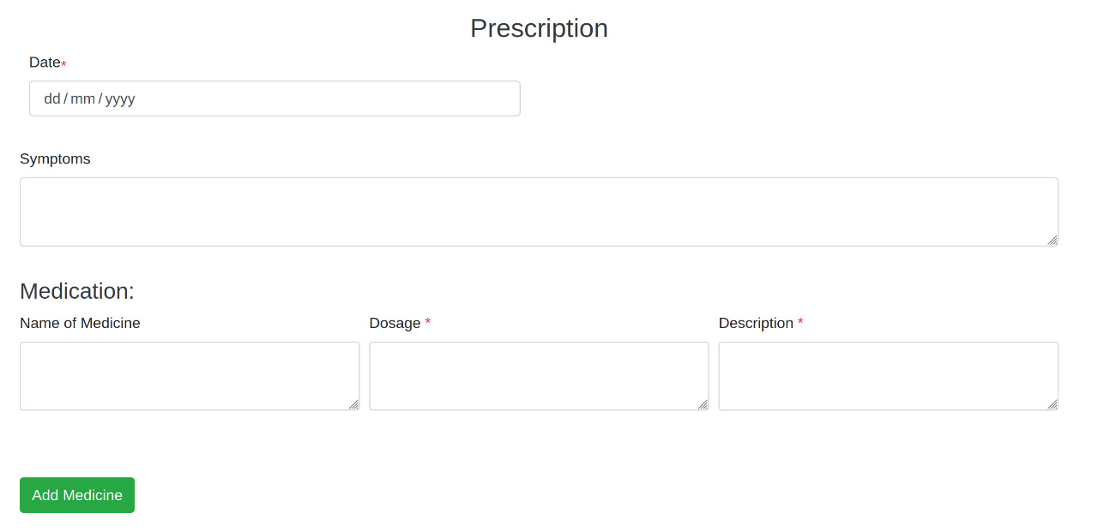

Slide 16
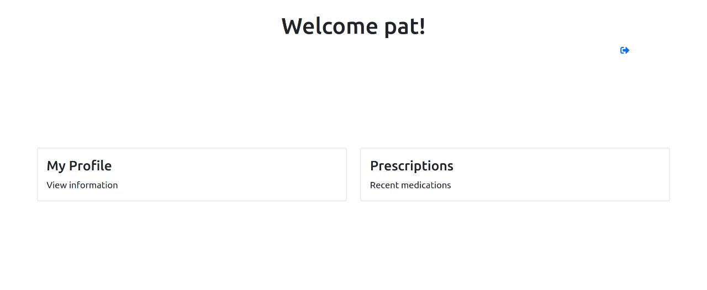
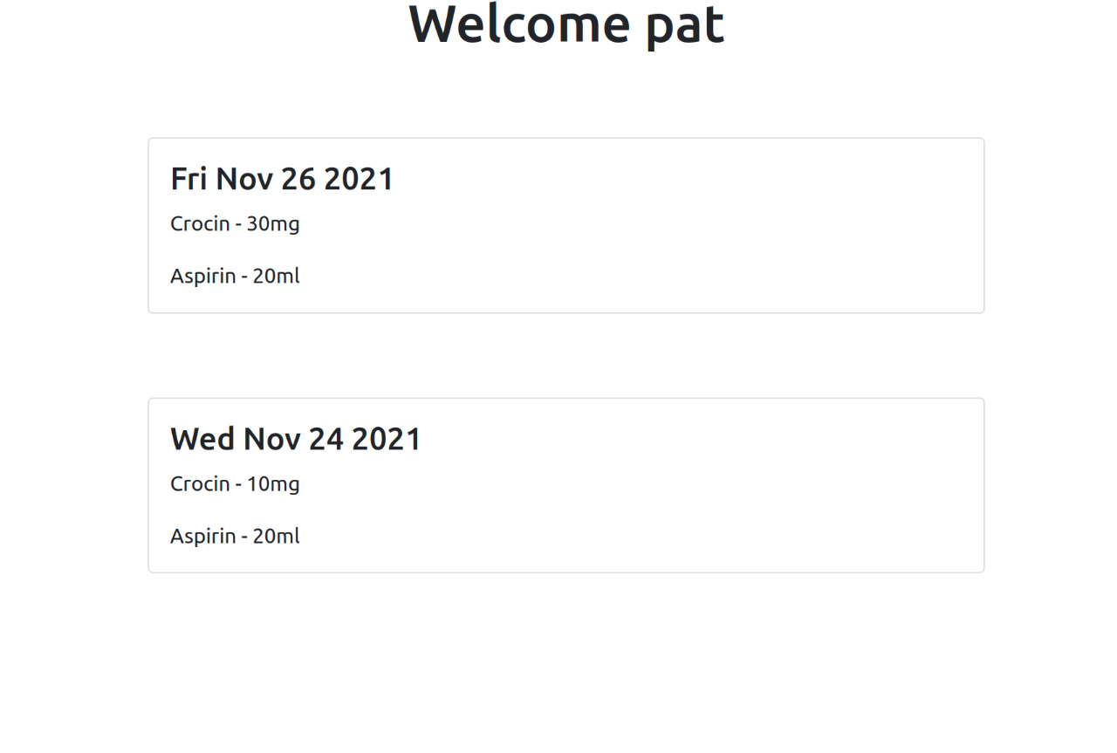
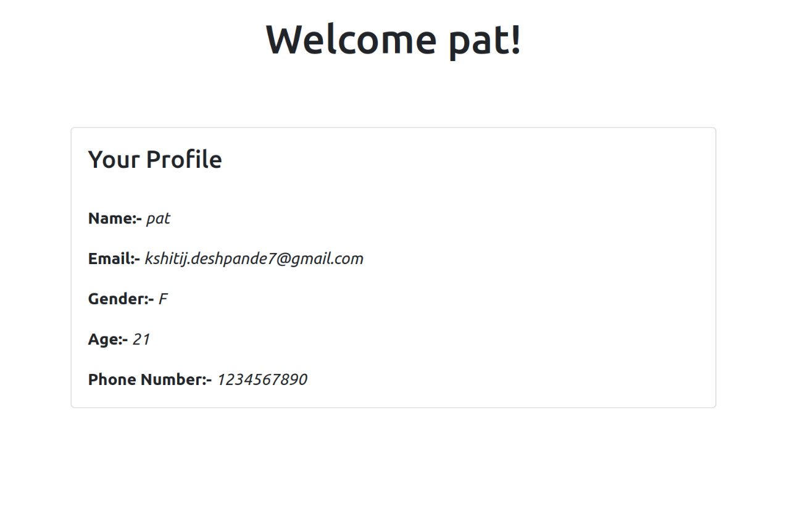

Slide 17
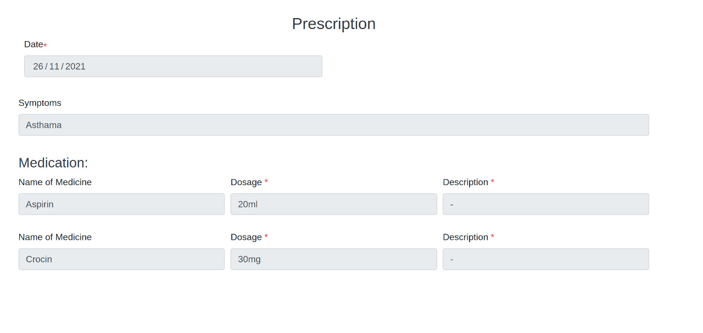

Slide 18
Video calling & chat feature to interact virtually with the doctor securely.
FUTURE SCOPE
Enabling blockchain security features for securely storing records in the database.
Registering on the platform can be made more authentic by involving government agencies for document verification.
Integrating with a mobile app.

Slide 19
CONCLUSION
In this project, common platform for doctors, patients & pharmacists has been implemented. It solves the problem of handwritten prescriptions. A fast and secure system is designed and implemented where patient's data is protected and not accessible by any other patient or user. MongoDB is used as the database for storing doctors, patients and pharmacists data. The software can be optimized further by making it more flexible and secure.

Slide 20
THANK YOU

